Slide 1
Customer Support via Power BI Social Media Channels Plan of Record
February 2018

Slide 2
Power BI Triage Plan Overview
Level of importance (1=low, 3=high) | Types | CSS Commercial Team Action | C+E Community Manager Action | Follow-up actions | Action ETA
1 | Kudos | None | Thank and engage user. | None. | N/A
1 | “Rants” | None. | None. | None. | N/A
1 | Remarks about competitors | None. | None. | Inform compete when appropriate. | N/A
1 - 3 | Inquiries on roadmap plans | Ask user to follow us to stay-up-to date with our releases. Example | None - CSS Commercial Team handles. | Document. Send to product marketing team. Alert PR if needed. | Depending on comment.
2 | Wish for new features/product enhancements | Thank. Direct user to Ideas page. | None - CSS Commercial Team handles. | Document feedback comments. Send to product marketing team. | Monthly.
2 | Feedback on products | Thank. Direct user to Ideas page. | None - CSS Commercial Team handles. | Document feedback comments. Send to product marketing team. | Monthly.
2 | Requests for PR contact (see notes)** | Direct to PR contact page. | None - CSS Commercial Team handles. | None. | N/A
3 | How-to requests | Provide information and/or links to support page. Send link to forum for immediate resources.* | None - CSS Commercial Team handles. | Document feedback comments. Send to product marketing team. | ASAP.
3 | Other Power BI requests (see examples on slide 7-9) | Obtain answer from appropriate contact via email, then respond to user. | C+E Community Manager CCd on email communication. | Document feedback comments. Send to product marketing team. | ASAP.
C+E social channels have over 5M followers
Notes:
**Requests for PR contact includes any request to contact MSFT PR team for news inquiries. Example: https://twitter.com/escapeartistes/status/890158691621720064
*When additional information is needed to answer user questions, C+E Social only requests information from users that is publicly available online.

Slide 3
Power BI Triage Process
CSS Commercial Team assigns themselves the triage query
CSS Commercial Team monitors all incoming replies, mentions, and direct messages for Power BI
CSS Commercial Team responds to user
CSS Commercial Team closes the ticket
Triage inquiry posted by user
C+E Community Manager assigns CSS Commercial Team the query
C+E Community Manager monitors all incoming replies, mentions, direct messages, and hashtags for Power BI
C+E Community Manager assigns themselves the engagement opportunity
C+E Community Manager replies and engages with user
C+E Community Manager closes the engagement
Engagement opportunity posted by user
Notes:
Power BI social only publishes content between the hours of 9 AM – 5 PM PT, Monday – Friday

Slide 4
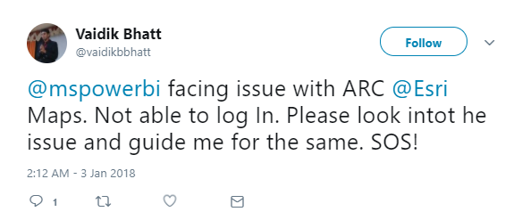
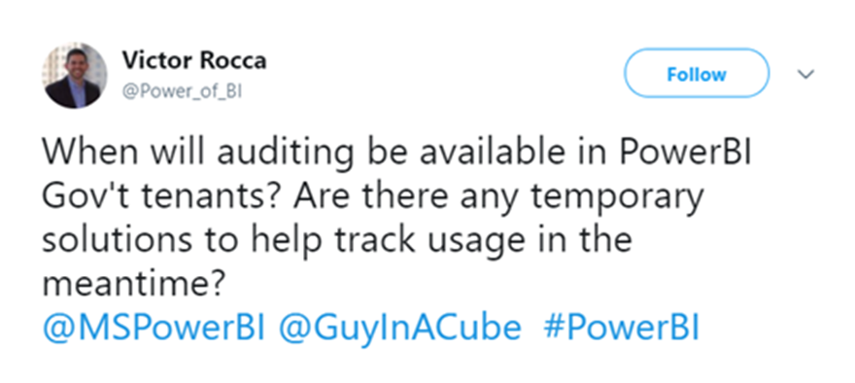
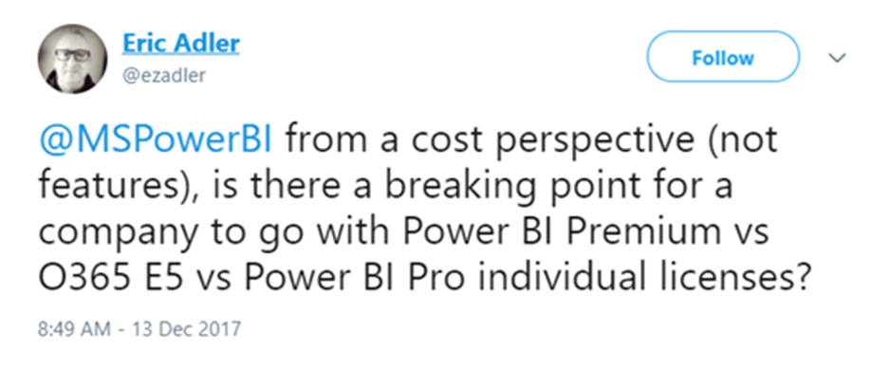
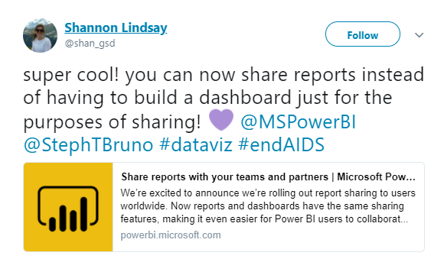
Power BI Triage Examples
How–to Issue or Inquiry
(CSS Commercial Team Responds)
Roadmap Inquiry
(CSS Commercial Team Responds)
Commercial Inquiry
(CSS Commercial Team Responds)
Positive Engagement Opportunity
(C+E Community Manager Responds)

Slide 5
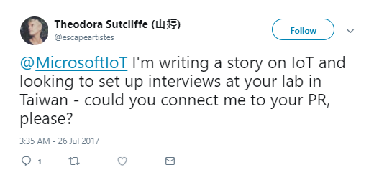
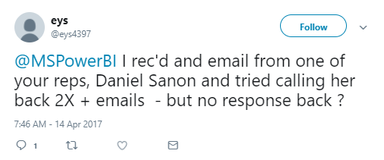
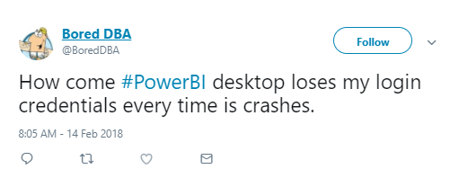
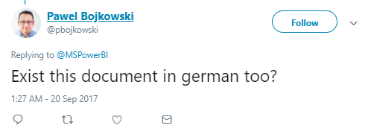
Power BI Triage Examples
PR Request
(CSS Commercial Team Responds- direct to PR Contact page)
Creative Asset Inquiry
(CSS Commercial Team Responds)
Reactive Content (Hashtags)
(C+E Community Manager Monitors & Assigns, CSS Commercial Team Responds)
Accessibility or Content Questions
(CSS Commercial Team Responds)

Slide 6
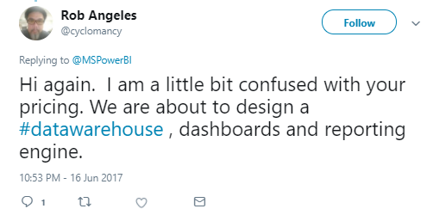
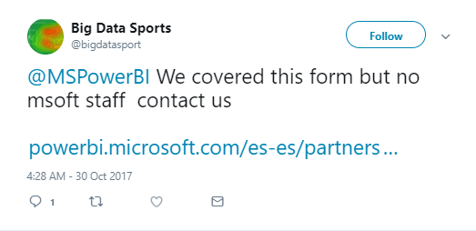
Power BI Triage Examples
Pricing Questions
(CSS Commercial Team Responds)
Website-related issues
(CSS Commercial Team Responds)

Slide 7
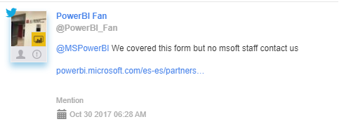
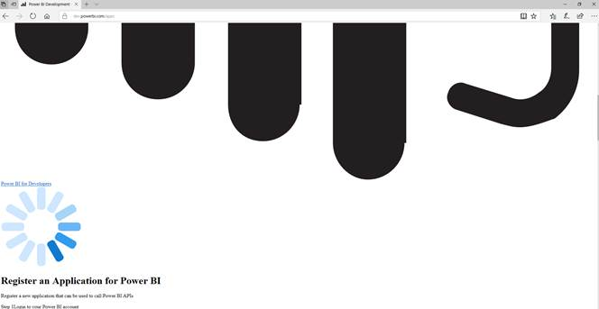
Web site related content
Customers following up on various forms submitted through PBI web sites ie:
https://powerbi.microsoft.com/en-us/partners/get-listed/
Broken links or broken sites ie:
This customer raised issue with broken links from:
https://dev.powerbi.com/apps
https://docs.microsoft.com/en-us/power-bi/developer/register-app#register-with-the-azure-portal.

Slide 8
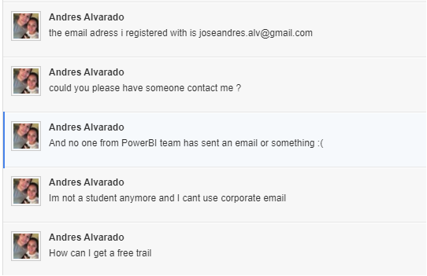
Web site related content
Customers following up on Free Demo trials ie:
https://info.microsoft.com/CO-PowerBI-ContactMe-Register.html
https://info.microsoft.com/CO-PowerBI-RequestADemo-Register.html

Slide 9
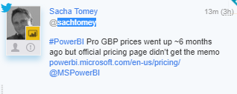
Pricing questions
Pricing questions:
This is something that we respond but ALWAYS in collaboration with Marketing teams or PMs. This is because a lot of the times there are either PR, or legal related questions/issues that come into play so we always look for

Slide 10
Influencers
For customers who have over 5K followers, even if the scope is technical and therefore CSS scope, Marketing teams usually require us to get approval before replying back. Let us know if you’d like us to align anything new.
Escalation: Send to Fernanda first always. If Fernanda is OOF, Scott.

Slide 11
Power BI Triage Contacts
Resources for CSS Commercial Team
Contact: | Title: | Can help triage:
Amanda Cofsky amac@microsoft.com | Program Manager | Website issues (primary contact), pricing questions Accessibility/Content issues
Jae Taylor jatayl@microsoft.com | Senior Program Manager | Website issues (secondary contact)
Richard Tkachuk richtk@microsoft.com | Principal Program Manager | Website issues (secondary contact)
Sandy Rivas sandy.rivas@microsoft.com | Program Manager | Community-related questions
Chauncy Freels chaunf@microsoft.com | Product Marketing Manager | Pricing questions b2b Escalate to inside sales Demo support Creative asset inquiry
Chriss Cardwell chrissca@microsoft.com | Product Marketing Manager | Follow up on various PBI Forms
Power BI Solutions Page https://community.powerbi.com/t5/Issues/idb-p/Issues
Feedback Wishlist: https://community.powerbi.com/t5/Issues/idb-p/Issues
Request for PR: https://news.microsoft.com/microsoft-public-relations-contacts/#8rWeQ7tUig7us8Cw.97
Contact a Power BI Expert (Sales): https://info.microsoft.com/CO-PowerBI-ContactMe-Register.html
Request a Power BI Demo (Sales): https://info.microsoft.com/CO-PowerBI-RequestADemo-Register.html

